Slide 1
Locality of storage access

Slide 2
Why is access locality important?
Access locality refers to the ability of software to make good use of the cache. (details on Cache in a following video)
Memory is broken up into pages.
Software that uses the same or neighboring pages repeatedly has good access locality.
Hardware is designed to speed up such software.

Slide 3
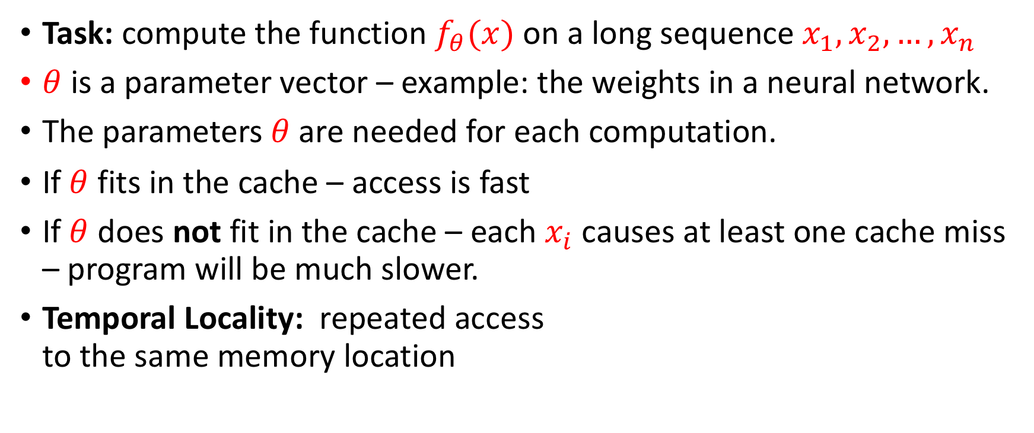
Temporal Locality
Task: compute the function $f_{θ}(x)$ on a long sequence $x_{1},x_{2},…,x_{n}$
$θ$ is a parameter vector – example: the weights in a neural network.
The parameters$θ$ are needed for each computation.
If $θ$ fits in the cache – access is fast
If $θ$ does not fit in the cache – each $x_{i}$ causes at least one cache miss – program will be much slower.
Temporal Locality: repeated access to the same memory location

Slide 4
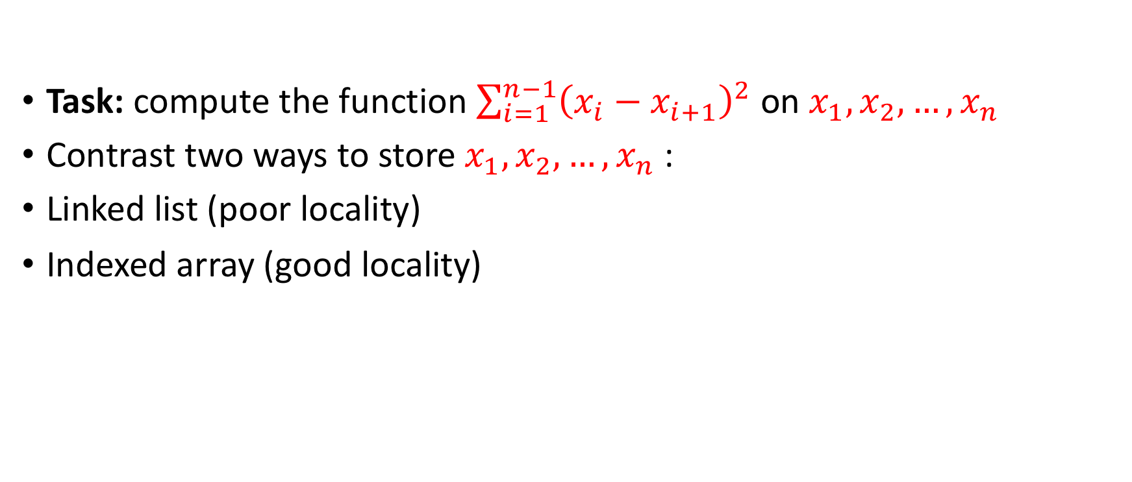
Spatial locality
Task: compute the function $\sum_{i=1}^{n−1}{{\left(x_{i}−x_{i+1}\right)}^{2}}$ on $x_{1},x_{2},…,x_{n}$
Contrast two ways to store $x_{1},x_{2},…,x_{n}$ :
Linked list (poor locality)
Indexed array (good locality)

Slide 5
Linked List
Let $x_{1},x_{2},…,x_{n}$ be 1,2,3,4,5,6
Page 1 |  |  |  |  | Page 2 |  |  |  |  | Page3 |  |  |  |  | Page4
 | 6 |  | 3 |  | 2 |  |  |  | 5 |  |  |  |  | 4 |  |  | 1
Traversal of 6 elements touches 4 pages

Slide 6
array
Let $x_{1},x_{2},…,x_{n}$ be 1,2,3,4,5,6
Page 1 |  |  |  |  | Page 2 |  |  |  |  | Page3 |  |  |  |  | Page4
 |  |  |  |  |  |  | 1 | 2 | 3 | 4 | 5 | 6
Traversal of 6 elements touches 2 pages

Slide 7
Word Count
Task: given a (large) text
Count the number of times each word
Output (word,count) sorted in decreasing order by Count.

Slide 8
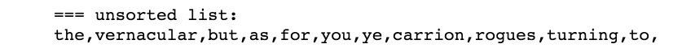
Unsorted word count / poor locality
Dict={}
For word in list:
if word in Dict:
Dict[word]+=1
else:
Dict[word]=1
Suppose
len(list)=1,000,000
len(Dict) = 100,000
Access to list: spatially local
Access to Dict: random

Slide 9
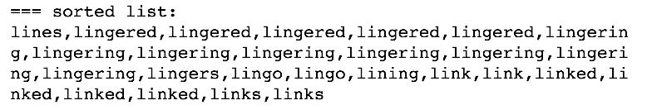
sorted word count / good locality
Suppose
len(list)=1,000,000
len(Dict) = 100,000
Access to list: spatially local
Access to Dict: Spatially local
But what about the sort step?
Sorting can be done in time O(n)
Efficient in distributed setup
Dict={}
Sort(list)
For word in list:
if word in Dict:
Dict[word]+=1
else:
Dict[word]=1

Slide 10
Summary
Improved memory locality reduces run-time
Why?
Because computer memory is organized in pages.
And caching retrieves a page at a time.

